Slide 1
Education 3.0 and the Connected Neuro-learner
Rob Kadel, Ph.D.
University of Colorado Denver

Slide 2
Sir Ken Robinson: Divergent Thinking
http://www.youtube.com/watch?v=zDZFcDGpL4U – 7:41 – 10:03
Notes:
http://www.youtube.com/watch?v=zDZFcDGpL4U – 7:41 – 10:03

Slide 3
Dr. Rob Kadel

Slide 4
Agenda
Learning to think differently
Thinking to learn differently: Education 3.0
Meeting your students in their space
Challenging your students in their space

Slide 5
Learning to Think Differently
1
What schools do teach vs.
What schools could teach

Slide 6
Schools Do Teach
K-12
College / University

Slide 7
Schools Do Teach…
…that Short Term Memory matters more than connection to culture, context, or reality

Slide 8
Divergent (Lateral) Thinking: How Many Piano Tuners Are In Chicago?
Notes:
Job: Product Manager
Photo: delgaudm
Answer: We'd answer "However many the market dictates. If pianos need tuning once a week, and it takes an hour to tune a piano and a piano tuner works 8 hours a day for 5 days a week 40 pianos need tuning each week. We'd answer one for every 40 pianos."
On Wikipedia, they call this a Fermi problem.
The classic Fermi problem, generally attributed to Fermi,[2] is "How many piano tuners are there in Chicago?" A typical solution to this problem would involve multiplying together a series of estimates that would yield the correct answer if the estimates were correct. For example, we might make the following assumptions:
1.There are approximately 5,000,000 people living in Chicago.
2.On average, there are two persons in each household in Chicago.
3.Roughly one household in twenty has a piano that is tuned regularly.
4.Pianos that are tuned regularly are tuned on average about once per year.
5.It takes a piano tuner about two hours to tune a piano, including travel time.
6.Each piano tuner works eight hours in a day, five days in a week, and 50 weeks in a year.
From these assumptions we can compute that the number of piano tunings in a single year in Chicago is
(5,000,000 persons in Chicago) / (2 persons/household) × (1 piano/20 households) × (1 piano tuning per piano per year) = 125,000 piano tunings per year in Chicago.
And we can similarly calculate that the average piano tuner performs
(50 weeks/year)×(5 days/week)×(8 hours/day)×(1 piano tuning per 2 hours per piano tuner) = 1000 piano tunings per year per piano tuner.
Dividing gives
(125,000 piano tuning per year in Chicago) / (1000 piano tunings per year per piano tuner) = 125 piano tuners in Chicago.
A famous example of a Fermi-problem-like estimate is the Drake equation, which seeks to estimate the number of intelligent civilizations in the galaxy. The basic question of why, if there are a significant number of such civilizations, ours has never encountered any others is called the Fermi paradox.

Slide 9
Convergent (“Test-taking”) Thinking:
There are approximately 5,000,000 people living in Chicago.
On average, there are two persons in each household in Chicago.
Roughly one household in twenty has a piano that is tuned regularly.
Pianos that are tuned regularly are tuned on average about once per year.
It takes a piano tuner about two hours to tune a piano, including travel time.
Each piano tuner works eight hours in a day, five days in a week, and 50 weeks in a year.
From these assumptions we can compute that the number of piano tunings in a single year in Chicago is __________.
(5,000,000 persons in Chicago) / (2 persons/household) × (1 piano/20 households) × (1 piano tuning per piano per year) = 125,000 piano tunings per year in Chicago
And we can similarly calculate that the average piano tuner performs _____ tunings per year.
(50 weeks/year)×(5 days/week)×(8 hours/day)×(1 piano tuning per 2 hours per piano tuner) = 1000 piano tunings per year per piano tuner.
So, there are approximately _______ piano tuners in Chicago.
(125,000 piano tuning per year in Chicago) / (1000 piano tunings per year per piano tuner) = 125 piano tuners in Chicago.
Notes:
It isn't the answer that’s important. It’s how we formulate the question. We'd probably answer: "However many the market dictates. If pianos need tuning once a week, and it takes an hour to tune a piano and a piano tuner works 8 hours a day for 5 days a week 40 pianos need tuning each week. We'd answer one for every 40 pianos.” A better use of our educational time might be to think laterally about this, to say, “Are these all the same piano? Are any electric? How old (or new) are some of these?” There is so much more to this question than just filling in the blanks.
This is called a Fermi problem. Enrico Fermi – determine estimates based on known facts. This gives us a general idea of the answer. The CONVERGENT (i.e., non-lateral) thinking is when the instructor leads the students down this path. Then it has nothing to do with creativity. It’s all about fill-in-the-blank.
A famous example of a Fermi-problem-like estimate is the Drake equation, which seeks to estimate the number of intelligent civilizations in the galaxy. The basic question of why, if there are a significant number of such civilizations, ours has never encountered any others is called the Fermi paradox.

Slide 10
Schools Do Teach…
…that Short Term Memory matters more than connection to culture, context, or reality
…Follow the template to succeed

Slide 11
Template Education Questions:
How many pages in the paper?
How many citations do you want?
How many slides in the presentation?
Can I see an example of a successful project from last term?

Slide 12
Solving symptoms
Schools do teach:

Slide 13
Schools do teach: Solving Symptoms
Average KwH usage per home in the USA: >11,000 KwH / year
Wind Turbines average 11,200 KwH / year (depending on size of turbine)
Home Solar Panels average 4,320 KwH / year (depending on how many)

Slide 14
Solving symptoms We need more power…
Schools do teach:

Slide 15
Schools could teach: Finding (new) Solutions
PHIUS: Passive House Institute of US
Average KwH per home in the USA: >11,000 KwH / year
Average KwH per PHIUS home: <1,500 KwH / year

Slide 16
Schools Do Teach…
…Short Term Memory matters more than connection to culture, context, or reality
…Follow the template to succeed
…Failure is not an option
Thomas Edison: I am not discouraged, because every wrong attempt discarded is another step forward.
Notes:
Thomas Edison's teachers said he was, "too stupid to learn anything."
He was fired from his first two jobs for being "non-productive."
As an inventor, Edison made 700+ unsuccessful attempts at inventing the incandescent light.
BUT he said…

Slide 17
Thinking to Learn Differently
2

Slide 18
Memory Test
Candy
Sour
Sugar
Bitter
Good
Tooth
Taste
Nice
Honey
Chocolate
Soda
Heart
Cake
Pie
Eat
Notes:
Everyone is interested in knowing how well they remember so let us take a simple memory test. The test (Figure 7.2) will present a list of 15 words, then there will be a pause and you will be asked whether you remember some of those words. Sorry, you have to put your pen down for this test and do not read further in the Chapter until you complete the test.
This memory test called the DRM test after its creators James Deese, Henry Roediger and Kathleen McDermott. It was not meant to be a trick, but to illustrate a very interesting and important feature about memory. We like to think that memory is similar to taking a photograph and placing that photograph into a filing cabinet drawer to be withdrawn later (recalled) as the “memory” exactly the way it was placed there originally (stored). But memory is more like taking a picture and tearing it up into small pieces and putting the pieces in different drawers. The memory is then recalled by reconstructing the memory from the individual fragments of the memory. The reason so many individuals incorrectly believe that “sweet” was on the list is because there were so many other words on the list that had a sweet connotation. “Failing” this test is actually not a bad outcome. Individuals with Alzheimer’s disease generally do not say that “sweet” was on the list. They cannot make the normal associations involved in the recall of a memory.
The word list gives insights into memory processing and retrieval, but it is not a really good test of “raw” memory ability because it can be affected by distortions and biases.

Slide 19
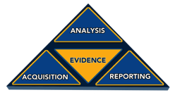
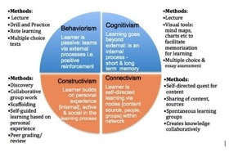
Learning Design
Learning Design
Behavioral Science
Cognitive Psychology
Education Theory
Instructional Design

Slide 20
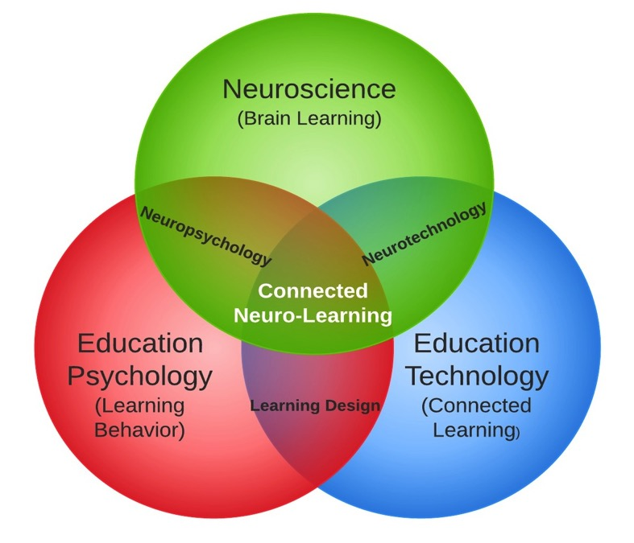
Education 3.0
Notes:
We have educational psychology, we have neuroscience, and we have educational technology. At the intersection of those three is what researchers have termed the “Connected Neuro-learner.” Now, that’s a big term, so let’s unpack it a bit.

Slide 21
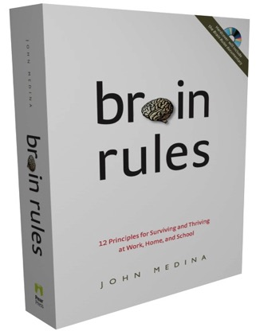
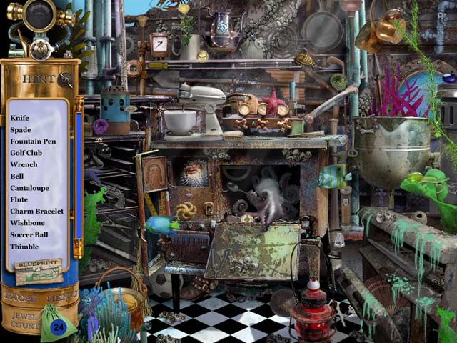
We Know (more) About the Brain…

Slide 22
Pattern Recognition

Slide 23
Pattern Recognition
Notes:
Now, an important thing happens to us when we recognize patterns. An important thing happens to our brains. John Medina tells us that when we recognize patterns, our brains do two things: they release dopamine and they release endorphins. Endorphins are chemicals that stimulate us, they excite us. Dopamine is a chemical that relaxes us. So, when we recognize patterns, two things are happen simultaneously. We are both excited and relaxed at the same time. And pattern recognition is one of the few times in our lives when this happens to us. Medina tells us that this is a key process in learning because when we can get students to be both relaxed and excited at the same time, they will learn more; and what’s more, they will crave those kinds of learning experiences. So pattern recognition is essential to a new way of learning to becoming that connected neuro-learner.

Slide 24
Hidden Patterns

Slide 25
Hidden Patterns
Notes:
These are all paintings from an American artist named Bev Doolittle. There are 13 faces.

Slide 26
Oral Information - Memory
Notes:
John Medina – Study participants remembered the content of over 90% of 2500 images several days following the presentation, even after seeing the images for only 10 seconds and 63% of images 3 months later.
Study participants remembered the content of 10% of information presented orally 3 days later…

Slide 27
Oral Information - Memory
Notes:
John Medina – Study participants remembered the content of over 90% of 2500 images several days following the presentation, even after seeing the images for only 10 seconds and 63% of images 3 months later.
Study participants remembered the content of 10% of information presented orally 3 days later…

Slide 28
Oral Information - Memory
Notes:
John Medina – Study participants remembered the content of over 90% of 2500 images several days following the presentation, even after seeing the images for only 10 seconds and 63% of images 3 months later.
Study participants remembered the content of 10% of information presented orally 3 days later…

Slide 29
Memory
Was the word “Candy” in the list?
Was the word “Car” in the list?
Was the word “Sweet” in the list?
YES
NO
NO
Notes:
This memory test called the DRM test after its creators James Deese, Henry Roediger and Kathleen McDermott. It was not meant to be a trick, but to illustrate a very interesting and important feature about memory. We like to think that memory is similar to taking a photograph and placing that photograph into a filing cabinet drawer to be withdrawn later (recalled) as the “memory” exactly the way it was placed there originally (stored). But memory is more like taking a picture and tearing it up into small pieces and putting the pieces in different drawers. The memory is then recalled by reconstructing the memory from the individual fragments of the memory. The reason so many individuals incorrectly believe that “sweet” was on the list is because there were so many other words on the list that had a sweet connotation. “Failing” this test is actually not a bad outcome. Individuals with Alzheimer’s disease generally do not say that “sweet” was on the list. They cannot make the normal associations involved in the recall of a memory.
The word list gives insights into memory processing and retrieval, but it is not a really good test of “raw” memory ability because it can be affected by distortions and biases.

Slide 30
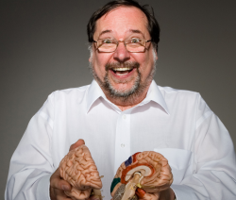
Dr. John Medina
“As I was writing Brain Rules, it hit me [that] if you wanted to design a learning environment that was directly opposed to what the brain is naturally good at doing, you would design something like a classroom.”

Slide 31
Learning Theory / Psychology
Bloom’s Taxonomy
Curriculum Integration
Piaget (Schema, Scaffolding, Social Development, Etc.)
Collaboration
Authentic Assessment
Competency Based Learning
Knowles Learning Principles
Maslow’s Hierarchy of Needs
Gardner’s Multiple Intelligences
And More!
Notes:
Also at the center of the connected neuro-learner is a ton of educational psychology and research into how we learn not only most effectively, but also in multiple, different ways. We’re goal-oriented. We’re practical. We are internally motivated to learn. We learn in different ways – each of us – based upon individual traits like being a visual learner, being a physical learner, being an interpersonal learner.
Knowles identified the six principles of adult learning outlined below.
Adults are internally motivated and self-directed
Adults bring life experiences and knowledge to learning experiences
Adults are goal oriented
Adults are relevancy oriented
Adults are practical
Adult learners like to be respected
Gardner’s Multiple Intelligences
Visual-Spatial - think in terms of physical space, as do architects and sailors. Very aware of their environments. They like to draw, do jigsaw puzzles, read maps, daydream. They can be taught through drawings, verbal and physical imagery. Tools include models, graphics, charts, photographs, drawings, 3-D modeling, video, videoconferencing, television, multimedia, texts with pictures/charts/graphs.
Bodily-kinesthetic - use the body effectively, like a dancer or a surgeon. Keen sense of body awareness. They like movement, making things, touching. They communicate well through body language and be taught through physical activity, hands-on learning, acting out, role playing. Tools include equipment and real objects.
Musical - show sensitivity to rhythm and sound. They love music, but they are also sensitive to sounds in their environments. They may study better with music in the background. They can be taught by turning lessons into lyrics, speaking rhythmically, tapping out time. Tools include musical instruments, music, radio, stereo, CD-ROM, multimedia.
Interpersonal - understanding, interacting with others. These students learn through interaction. They have many friends, empathy for others, street smarts. They can be taught through group activities, seminars, dialogues. Tools include the telephone, audio conferencing, time and attention from the instructor, video conferencing, writing, computer conferencing, E-mail.
Intrapersonal - understanding one's own interests, goals. These learners tend to shy away from others. They're in tune with their inner feelings; they have wisdom, intuition and motivation, as well as a strong will, confidence and opinions. They can be taught through independent study and introspection. Tools include books, creative materials, diaries, privacy and time. They are the most independent of the learners.
Linguistic - using words effectively. These learners have highly developed auditory skills and often think in words. They like reading, playing word games, making up poetry or stories. They can be taught by encouraging them to say and see words, read books together. Tools include computers, games, multimedia, books, tape recorders, and lecture.
Logical -Mathematical - reasoning, calculating. Think conceptually, abstractly and are able to see and explore patterns and relationships. They like to experiment, solve puzzles, ask cosmic questions. They can be taught through logic games, investigations, mysteries. They need to learn and form concepts before they can deal with details.

Slide 32
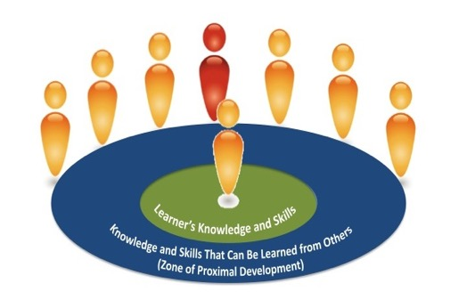
Vygotsky
Notes:
Vygotsky was a researcher in the early part of the 20th Century, but his work still informs our understanding of how individuals learn in groups. Vygotsky said that in order for constructive learning to take place, each group of learners had to have what he termed the “more knowledgeable other.” This is key to group learning.

Slide 33
Choice Drives Constructivism
Flipped Learning
Maker Movement
Challenge Based Learning
Problem Based Learning
Service Learning

Slide 34
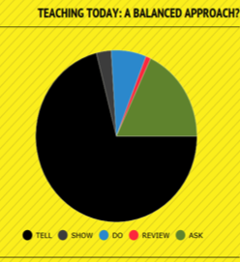
TELL
SHOW
DO
REVIEW
ASK
DO
SHOW
TELL
REVIEW
ASK

Slide 35
Jack Mezirow: Transformative Learning
Experimentation
Active
AND/OR
Reactive
Discourse
Internal
AND/OR
External
Context
Conclusion(s)
Thought
AND
Action
Context
Context
(Personal) Catalyst
Intrinsic-Paradigm
OR
Extrinsic-Paradigm
Paradigm Creation
Reflective
AND/OR
Proactive
Context

Slide 36
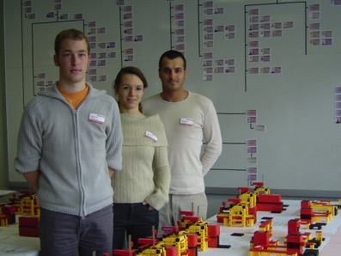
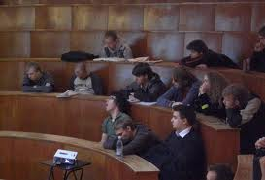
Choice & Motivation in Learning Matter
Rate your academic experience: 1-10
How did you first pick your classes?
Notes:
Pic 1: Harvard Freshman
Pic 2:
“At fischer Automotive Systems (fas) in Horb (Germany), trainee Murat Süzgün, BA students Isabell Schaub and Simon Traub built a 1:20 scale model of the production facilities. They were supported by the KVP representative Sabine Hinz and fischertechnik model designer Hermann Dongmann. The project required over 16,000 parts from fischertechnik for the 52 injection molding machines, 200 workbenches, 100 pallets and 100 shelves.
The team was capable of simulating various changes based on the models. All totaled, this allowed approx. 200 m² of space to be saved. Originally, fischer Automotive Systems was even considering an annex due to the lack of space. However, redesigning the plant hall was considerably more economical. This fischertechnik project allowed a great deal of money to be saved.”

Slide 37
Transformational Education (And Technology)
Constructivism
Problem Based Learning
Flipped Learning
1:1
Augmented Reality
Curriculum Integration
Alternate Reality Gaming
Transformational Learning
At-Risk Reporting
Educator Collaboration
MOOC
Administrator Evaluation
Authentic Assessment
Place-Based Learning
Geolocation
Simulation
Challenge Based Learning
Adaptivity
Personalization
Semantic Analysis
College Readiness
Creativity
Notes:
And lastly, when we talk about the connected neuro-learner, there is so much technology available for real transformational learning. Look at all of these different options, and tools, and ways of learning that we have available that our students can use. Let’s take a look at some of the tools that are providing those experiences by looking at social media – not just in education, but let’s start with social media just in general use in society.

Slide 38
Putting it all Together (in the future) School of Thought: Simone’s Story
http://youtu.be/yQRdIZR_LYY?list=PLy6xIE2-SrEkoHwjXvIz0R7QLaUQXcaII -- 1:12 to 2:44
Notes:
http://youtu.be/yQRdIZR_LYY?list=PLy6xIE2-SrEkoHwjXvIz0R7QLaUQXcaII -- 1:12 to 2:44

Slide 39
Meeting Your Students in Their Space
Divergent Lives vs. Convergent Schooling
3

Slide 40
Are Students Life-ready?
2008 Oxford Survey of “Most Important Employee Skills”
Employers said employees achieved 15% of these regularly

Slide 41
Schools could teach this…
Creativity, Questioning, Music, Art, Physical Education, Etc.
Critical Thinking, Application, Review Cycles, Etc.
Statistical Analysis, Probability, Satisfaction, Lateral Thinking, Etc.
Math, Reading, Writing, Language, Computers, Typing, Science, Etc.
And if they did…

Slide 42
…we could reach this
Notes:
2008 Oxford Survey of “Most Important Employee Skills”
Employers said employees achieved 15% of these regularly

Slide 43
How are students learning and interacting outside of school?

Slide 44
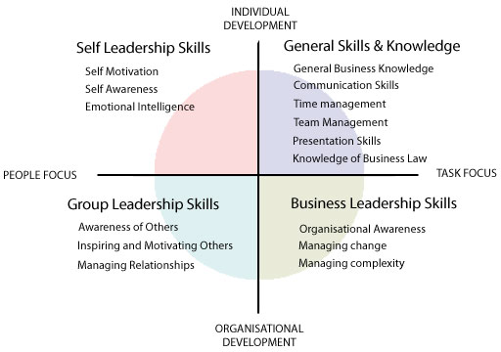
How are students learning and interacting outside of school?
Notes:
All of these tools on the left are teaching students many of the same skills on the right that we want them to have.

Slide 45
We have them on this side
We want them on this side
Traditional Schooling

Slide 46
Social media and social learning have cracked the shell of just about every facet of our lives…
…except schooling.

Slide 47
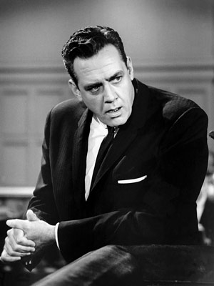
From Perry Mason…

Slide 48
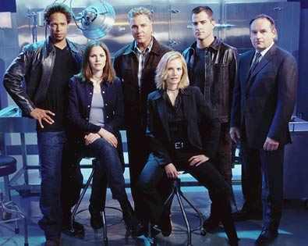
To teams of experts

Slide 49
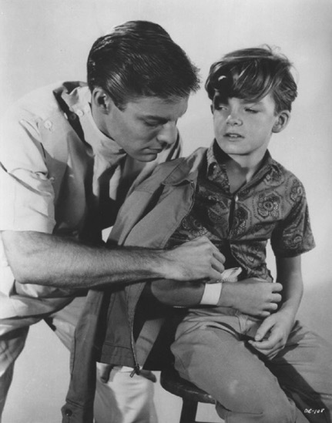
From Dr. Kildare…

Slide 50
To teams of professionals

Slide 51
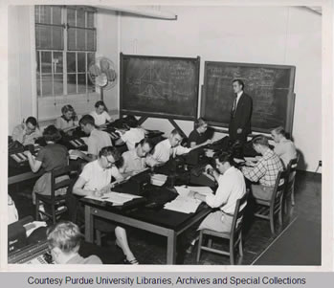
From Lone Teacher…

Slide 52
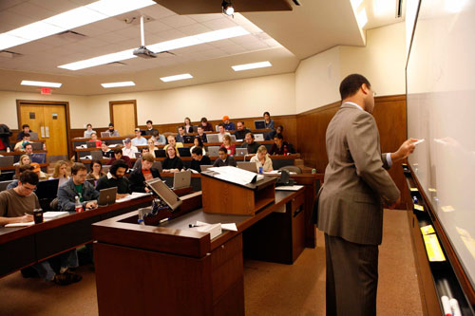
To Lone Teacher…

Slide 53
Harvard Assessment Seminars

Slide 54
Social Learning Matters
1990: 55% of science majors stayed majors
2000: 63% of science majors stayed majors

Slide 55
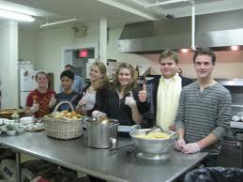
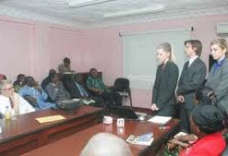
Light’s Harvard Assessment Series

Slide 56
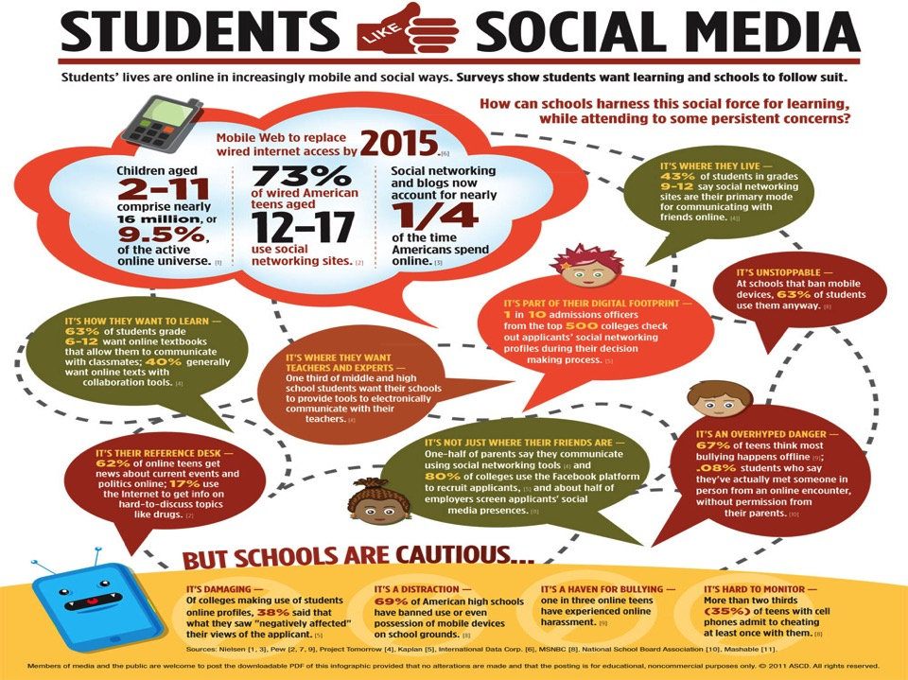
Notes:
These are legitimate concerns (at the bottom). But students are going to use these tools anyway. We can mitigate these risks as long as…

Slide 57
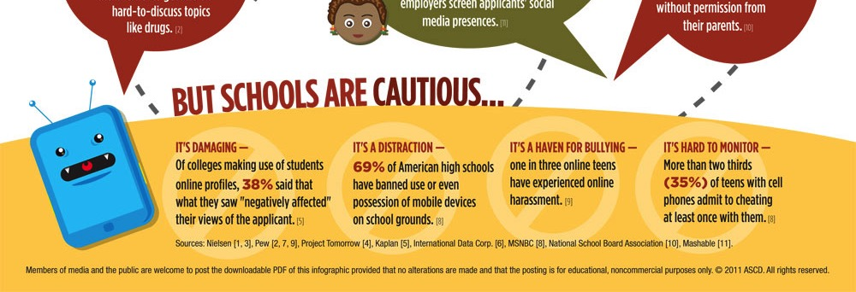
Notes:
These are legitimate concerns (at the bottom). But students are going to use these tools anyway. We can mitigate these risks as long as…

Slide 58
Things to Think About: Ethical Considerations
Is participation mandatory or voluntary?
How do you protect student data?
How do you protect students from online predators?
Other considerations?
Notes:
1) Start voluntary, maybe make mandatory exercises later. Posting photos or video? Make sure you have student/parent permission to do so. 2) Simple: NEVER share individual student data on publicly accessible pages. Save those for your Student Information System or Virtual Learning Environment. 3) Facebook “Audience Selector” – control who sees what information on students’ & educators’ activity. Page and Group admins can “lock down” pages, hide posts, restrict who posts by using the Admin panel.

Slide 59
Chicago Public Schools: 8 Questions for Every School Principal Before Creating a Social Media Presence
What audience do I want to reach?
How does this audience use social media now?
What kinds of actions do I want to drive?
What do I wish more people knew about my school?
What content could help me convince my audience to take those actions?
What content could help me tell them what they need to know in a way that they’ll remember?
How will I keep my social media presence secure?
How will I keep learning and get feedback?
Notes:
From Chicago Public Schools, for principals to ask/answer

Slide 60
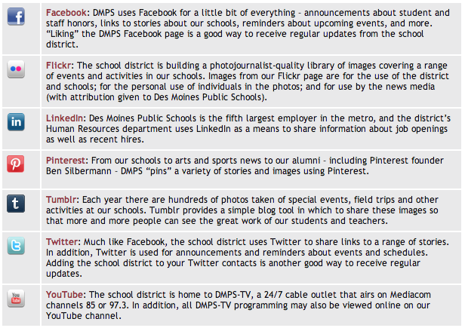
Des Moines, Iowa (USA): Multiple Social Media Channels

Slide 61
Your turn!
Why use social media to reach learning outcomes instead of some other, more traditional, approach?
What is being replaced by social, if anything?
How is the social media approach more effective (if it is)?
What criteria might you use to measure its effectiveness?
Notes:
Small group discussions? E.g., pick a question that is of most interest in your group, talk for 3 minutes, then larger group discussion.

Slide 62
Lateral Thinking: So Many Tools to Try…
Create a FB page to share news, allow students to contribute
iTunes U
Podcasts
Have students post pictures of projects
Try a “News Channel”
Tweet News, Updates, Links
Notes:
Students go from being CONSUMERS of knowledge to PRODUCERS of knowledge

Slide 63
Why is it so hard to share learning experiences with students? Typical faculty answer: "Because my content is…"
(Gollum saying, “My precious…”

Slide 64
Tools are just part of the equation…

Slide 65
Remember...
You're not "trying a tool."
You're not "migrating content."
You're not "sharing information."

Slide 66
But you are
Trying with
Migrating with
Sharing with...

Slide 67
Challenging Your Students in Their Space
4

Slide 68
Learning ≠ Schooling?
Notes:
Everything you do, everything you read, everything you explain to someone else is EDUCATION. It doesn't have to take place in a school or even in a Virtual Learning Environment or Learning Management System.

Slide 69
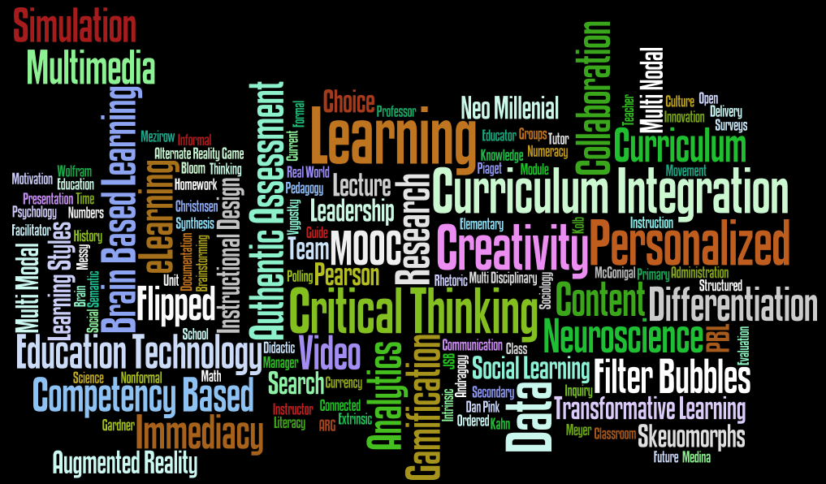
Learning Today

Slide 70
Instructional Strategies that Work
Curriculum integration
Problem-based learning
Challenge-based learning
Constructivism
Creativity
Critical thinking
Flipped learning

Slide 71
Sal Kahn & Carol Dweck: Challenge-based Learning and the Growth Mindset
http://youtu.be/wh0OS4MrN3E and watch from 00:00 to 02:20
Notes:
http://youtu.be/wh0OS4MrN3E and watch from 00:00 to 02:20

Slide 72
We can challenge them in so many ways in their own space!
Notes:
Lot’s of so-called Web 3.0 tools out there. BUT, there are some drawbacks…

Slide 73
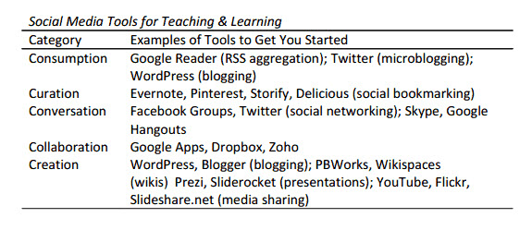
Navigating the C’s of Social Media
Notes:
Just remember…[CLICK]

Slide 74
The Dangers of Web 3.0?
Web 3.0
Notes:
This is the semantic Web, the Web that starts to think for us.

Slide 75
Filter Bubbles

Slide 76
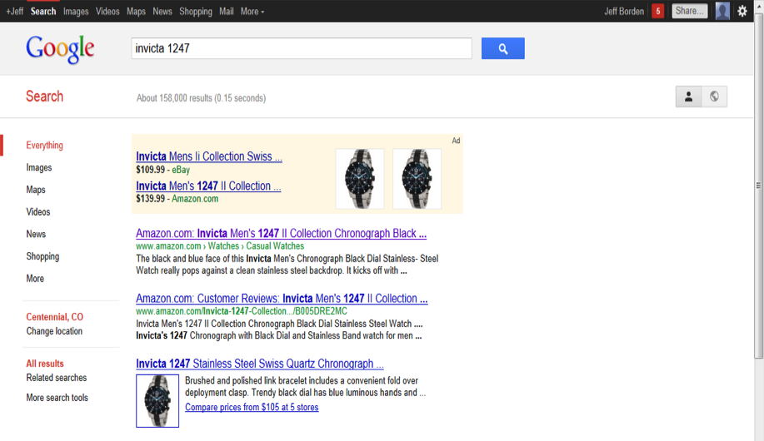
The Semantic Web: Buying a Watch

Slide 77
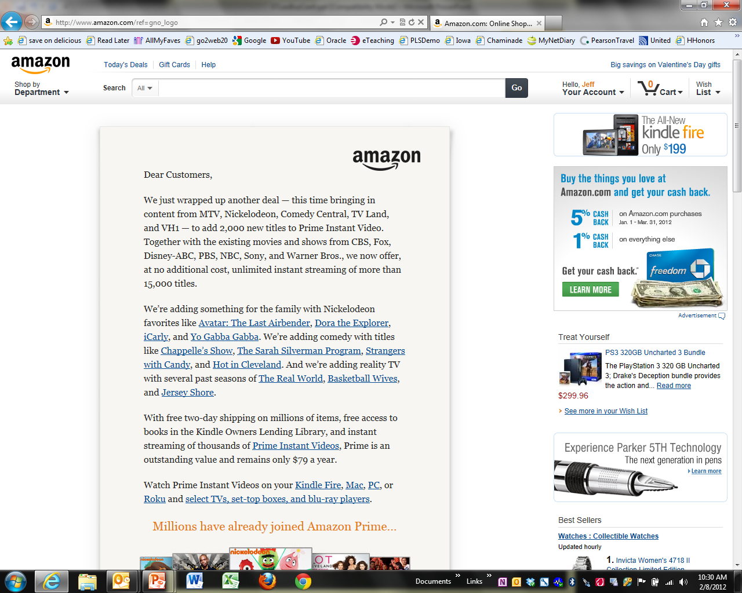
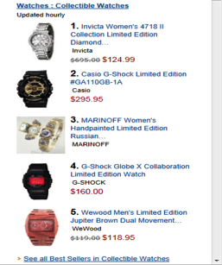

Slide 78
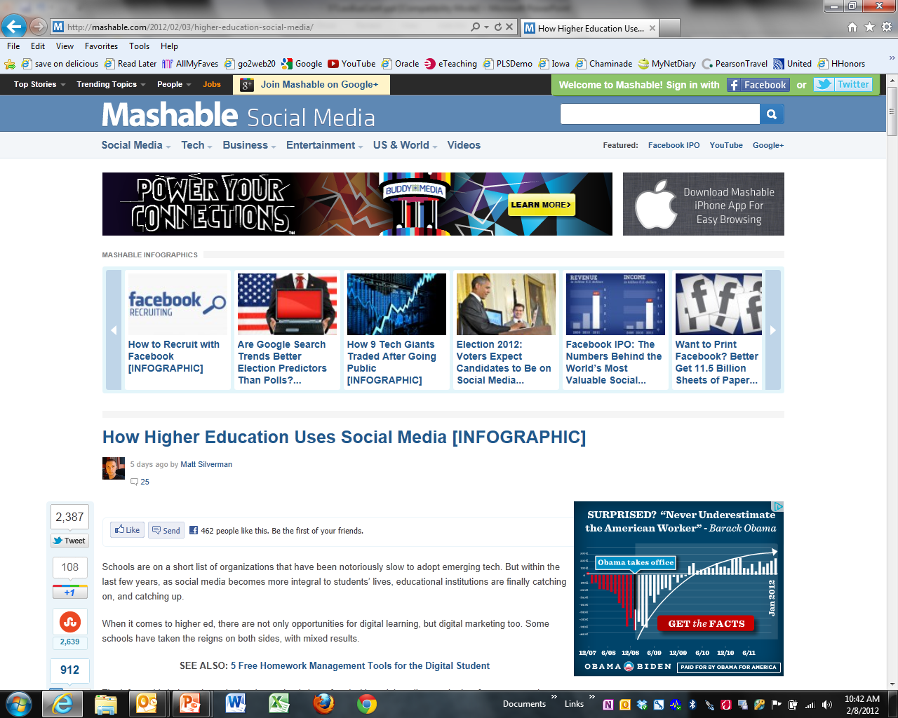

Slide 79
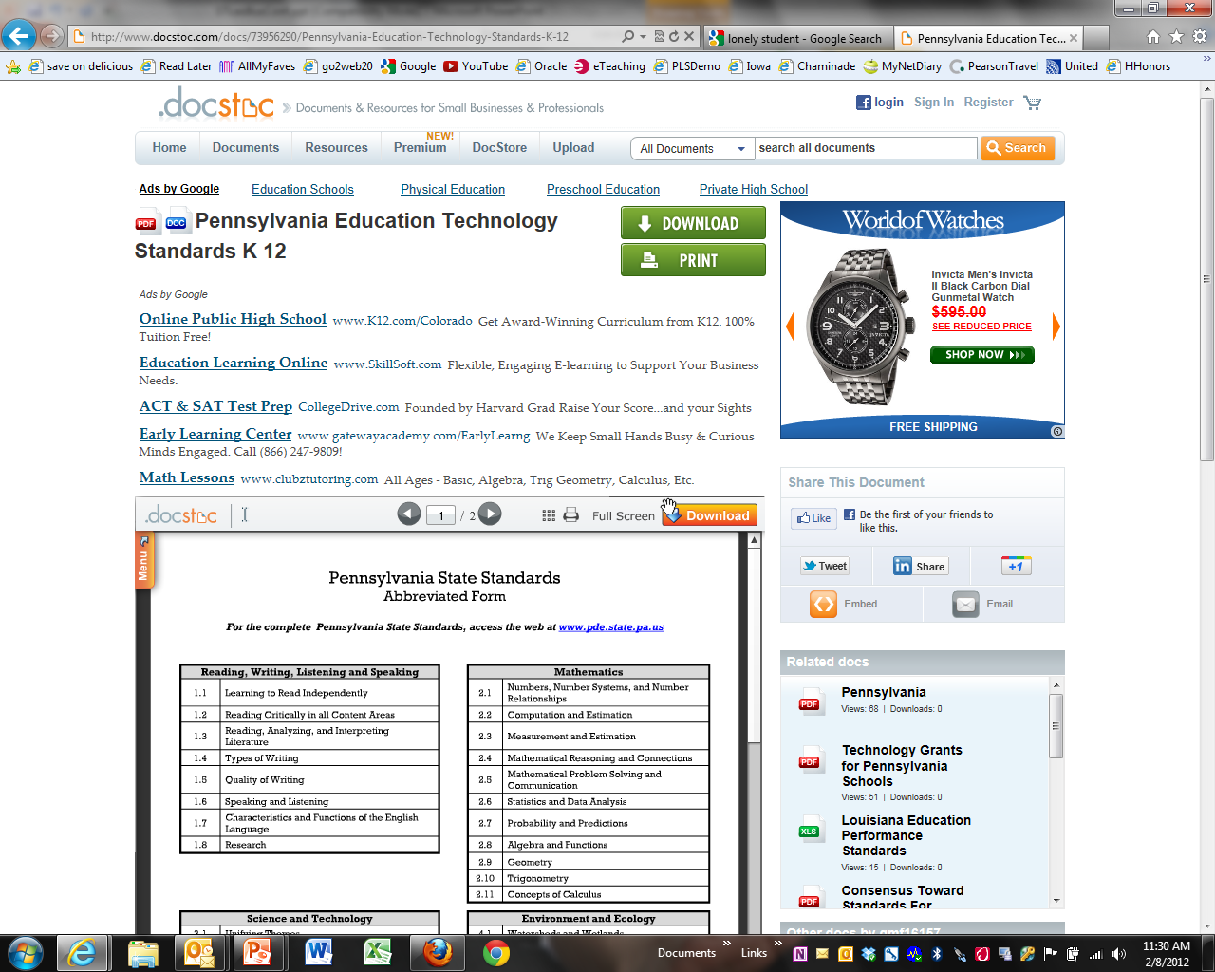

Slide 80
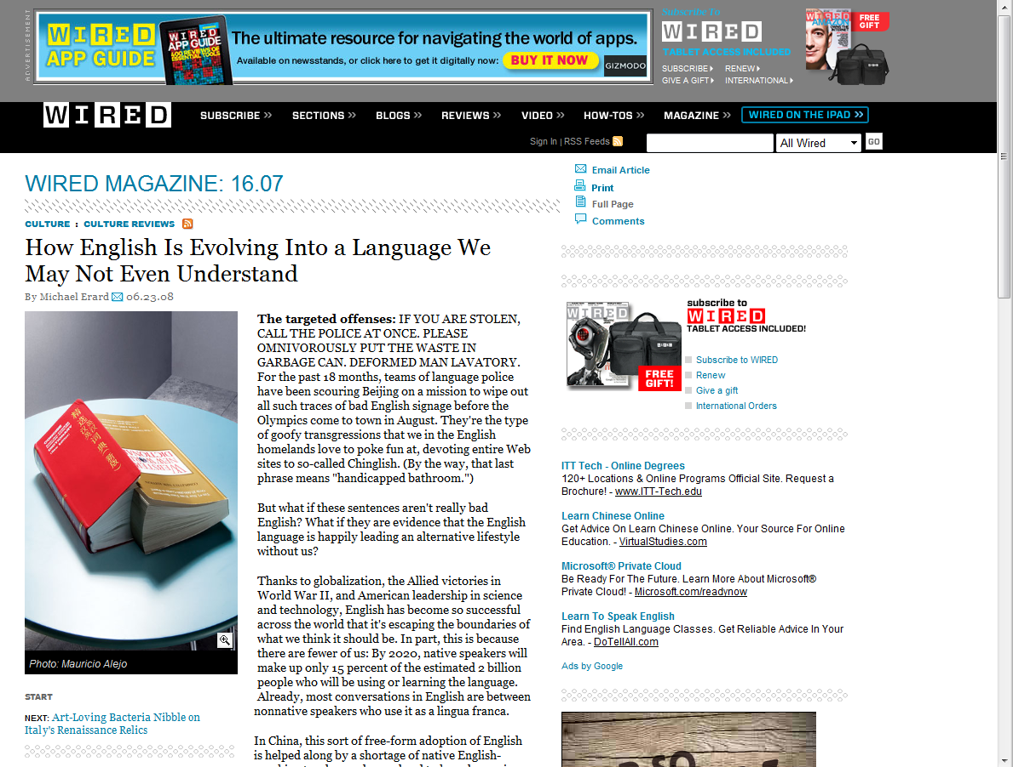
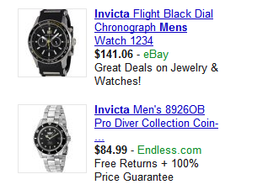

Slide 81
Surrounded By Information

Slide 82
You Determine Preferences

Slide 83
Who Determines Relevance?
Notes:
You don’t get to see what gets filtered out

Slide 84
Varied Results

Slide 85
Balanced Information Diet or Junk Food?

Slide 86
Algo-rhythms

Slide 87
Desired Filters

Slide 88
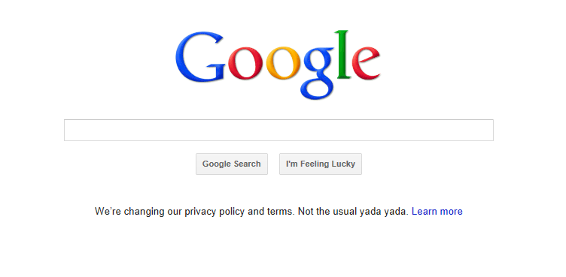
Undesired Filters

Slide 89
We’re Not Alone Anymore

Slide 90
We Are Connected

Slide 91
School: The Ultimate Filter Bubble?

Slide 92
Web of 1
Notes:
You don’t want it to turn into a Web of 1 by filtering out so much that there’s no one and nothing left but you.

Slide 94
Thank you!
Rob Kadel, Ph.D.
rob.kadel@ucdenver.edu
Twitter: @rkadel42
Web: robkadel.com

